Slide 1
Who’s in Control of Your Control System? Device Fingerprinting for Cyber-Physical Systems
Author: David Formby∗, Preethi Srinivasan∗, Andrew Leonardy, Jonathan Rogersy, Raheem Beyah∗
NDSS’16, 21-24 Febtuary, 2016, San Diego, CA, USA
Notes:
*喬治亞理工學院的電子與電腦工程學系的
沒標星號的是喬治亞理工學院的機械工程系的
(1) 電子與電腦工程學系的博士後 Researcher, Fortiphyd Logic 的 CEO, CTO(which provides cybersecurity solutions for industrial control systems (ICSs))
(2) 研究助理, 目前是 AWS Software Development Engineer
(3) IT Support Professional
(4) 機械工程系助理教授, Automation/Mechatronics: Robotics, applied dynamics, computational automation, nonlinear control and estimation
(5) 喬治亞理工學院電子電腦工程學系的教授 (1) privacy; (2) cybersecurity for critical infrastructure networks; (3) security in wireless networks; and (4) network monitoring and performance. co-founder of Fortiphyd Logic
NDSS = The Network and Distributed System Security Symposium
是和CCS，USENIX SECURITY及IEEE S&P 並稱的計算機系统安全領域的四大頂級會議之一。

Slide 2
Outline
Motivation and Contribution
Related Work
Threat, Assumptions, and Goals
Overview Of Device Fingerprinting Methods
Synthetic Fingerprint Generation
Discussion
Conclusion and Future Work

Slide 3
Motivation
An attacker intruding on an ICS network can theoretically inject false data or commands and drive the system into an unsafe state.
These injections could be thwarted using strong cryptographic protocols that provide integrity and authentication guarantees
But in ICS networks it is often infeasible to upgrade legacy equipment to provide such protocols.
lack of processing power, devices being in remote locations, and the critical nature of the systems that must be online at all times.

Slide 4
Motivation
Since adding cryptography to resource limited devices and keeping them patched is infeasible and impossible
Fingerprinting must be used to provide security and intrusion detection.

Slide 5
Contributions
Two novel fingerprinting approaches that take advantage of the unique characteristics of ICS devices
A new class of fingerprint generation specific to ICS networks using “white box” modeling
Performance analysis using both real world data from a power substation and controlled lab tests
Evaluation of the methods under simple forgery attacks for different classes of adversary

Slide 6
Related Work
Device fingerprinting methods are usually classified into active or passive techniques
depending on whether they actively probe a device with specially crafted packets or passively monitor network traffic to develop the fingerprint
Nmap, uses active fingerprinting techniques to gather information about devices on a network.
By sending a series of specific requests, Nmap determines the OS and server versions running on a machine based on how the device responds.

Slide 7
Related Work
For passive fingerprinting, a variety of techniques exist that provide both device type fingerprinting and individual device fingerprinting.
One example is the open source p0f tool, which passively examines TCP and HTTP header fields to determine information about a client, such as OS and browser version

Slide 8
Threat, Assumptions, and Goals
They consider two different attacker models:
1) an outsider who is unable to gain physical access but has compromised a low powered node in the network with malware
2) an outsider who is feasibly able to gain physical access to the target network and use her own portable machine with standard laptop computing power.

Slide 9
Threat, Assumptions, and Goals
The goal of this research is to develop accurate fingerprinting methods to distinguish between responses originating from a legitimate IED, an adversary with a laptop who has gained access to the network, or a comprised IED posing as a different device on the network.
Definition: Given a sequence of observations Oi every device i on the network, the goal of the fingerprinting methods will be to identify which Dj;k, those observations belong to.
j: vendor k: signifies the model for each vendor’s product

Slide 10
Overview Of Device Fingerprinting Methods
Two of the properties that differentiate ICS networks from more traditional networks are their primary functions of data acquisition through regular polling for measurements and control commands.
The two proposed methods proposed take advantage of these unique properties and are explained using the power grid as a specific example.

Slide 11
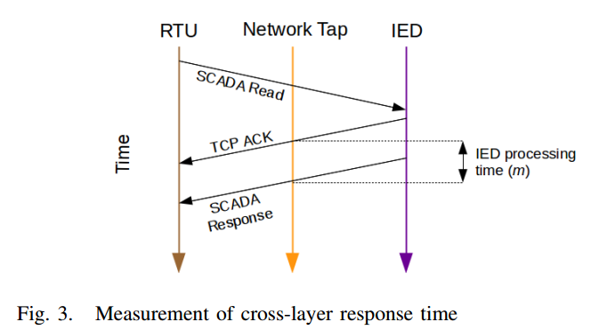
Method 1: Cross-layer Response Times(CLRT)
By leveraging the interaction between regular polling of measurement data at the application layer with acknowledgments at the TCP layer to get an estimate of the time a device takes to process the request
And then develops a fingerprint for each device based on the distribution of these times

Slide 12
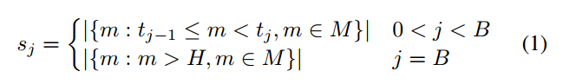

Method 1: Cross-layer Response Times(CLRT)
The fingerprint signature is defined by a vector of bin counts from a histogram of CLRTs where the final bin includes all values greater than a heuristic threshold.
M: a set of CLRT measurements from a specific device B: the number of bins in the histogram H: the heuristic threshold chosen to be an estimate of the global maximum that CLRT measurements should ever take $t_{i}: ⅈ\frac{H}{B−1}$ $s_{j}$: element of the signature vector

Slide 13
Method 1: Cross-layer Response Times(CLRT)
Theory: The CLRT measurement is advantageous for fingerprinting ICS devices because it remains relatively static and its distribution is unique within device types and even software configurations.
Device Characteristics. ICS devices have simpler hardware and software architectures because they are built to perform very specialized critical task
due to the limited processing power and fixed CPU load CLRTs can be leveraged to identify ICS device types

Slide 14
Method 1: Cross-layer Response Times(CLRT)
Network Level Characteristics: devices in ICS networks are dedicated to one critical task and are fixed in a permanent location.
The traffic generated from regular polling intervals travel will with extremely high probability take the same exact path, encounter the same delay, and therefore have a very consistent spacing in between them.
Due to this combination of low computational power, fixed CPU loads, and simple networks with predictable traffic, any significant change in a device’s distribution of CLRTs highly suggests network being intruded.

Slide 15
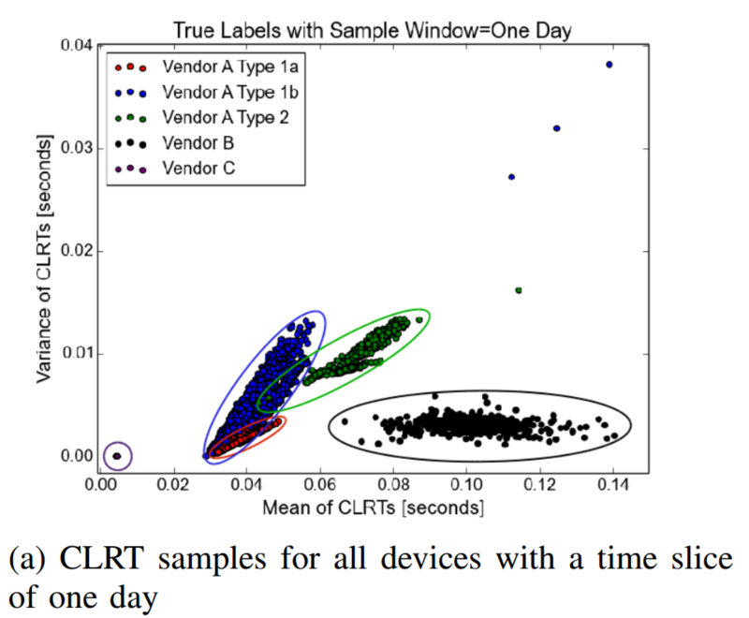
Method 1: Cross-layer Response Times(CLRT)
Experimental Setup: experiments were run at a large scale using a real world dataset as well as on a small scale using controlled lab tests.
Result:
Figure 6a illustrates that device types are clearly separable based on simple mean and variance measurements,

Slide 16
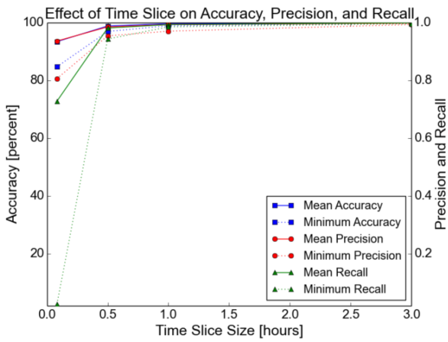
Method 1: Cross-layer Response Times(CLRT)
They used FF-ANN to classify the labeled data and achieved an average accuracy of 93% even when time slices as small as 5 minutes.

Slide 17
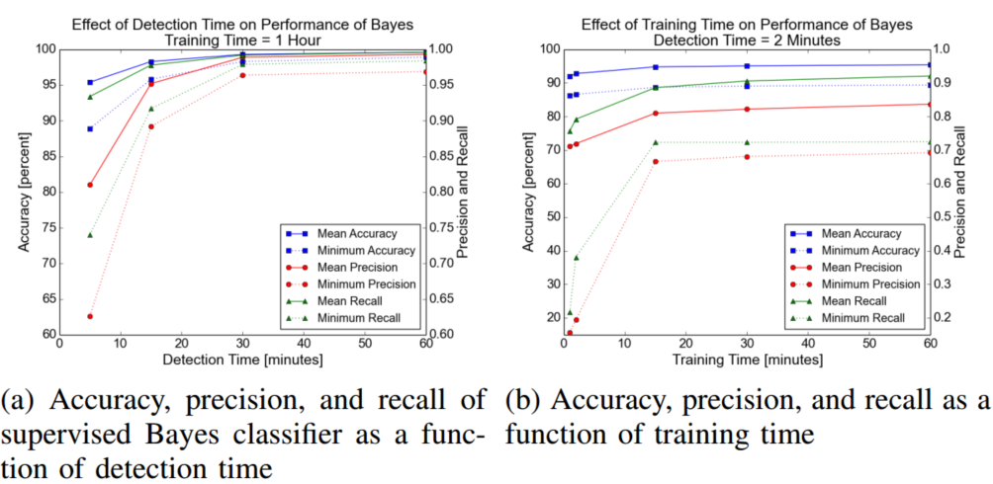
Method 1: Cross-layer Response Times(CLRT)
They used naive Bayes classifier on a experiment that simulate a real world deployment and can achieve high accuracy classification with detection times as small as a few minutes

Slide 18
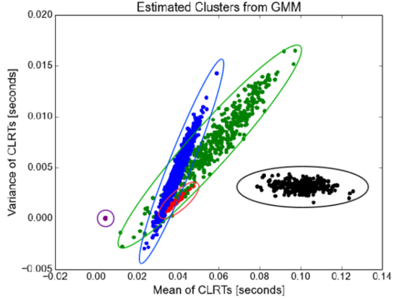
Method 1: Cross-layer Response Times(CLRT)
The estimated clusters learned from the GMM algorithm, which upon comparison with the true clusters in Figure 6a, looks very similar.
The model achieved an accuracy of 92.86%, a precision of 0.891, and a recall of 0.956.

Slide 19
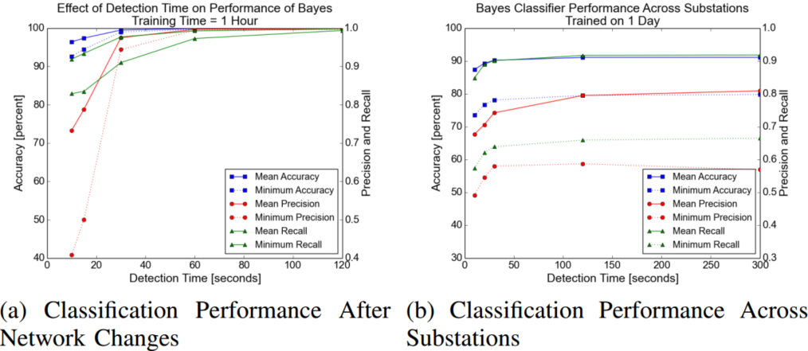
Method 1: Cross-layer Response Times(CLRT)
For the first experiment, the original substation was revisited over a year later after the network architecture had been upgraded and polling frequency had been increased.
For the second experiment, tested original model on a different substation over a year later.

Slide 20
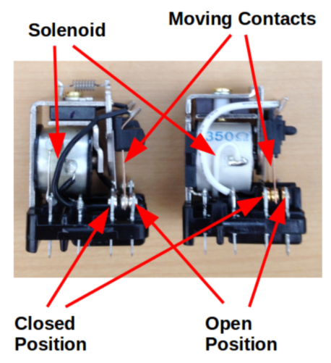
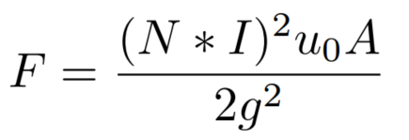
Method 2: Physical Fingerprinting
The second approach was fingerprinting physical devices based on their unique physical properties.
Theory: The mechanical and physical properties defining how quickly a device operates differs between devices and produces a unique fingerprint.
Example:

Slide 21
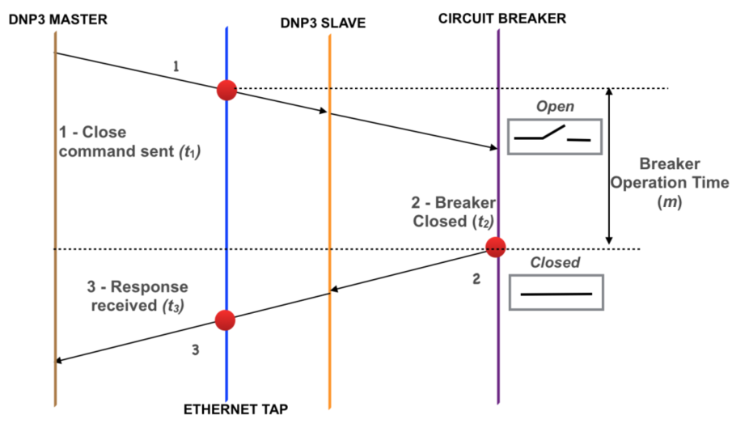
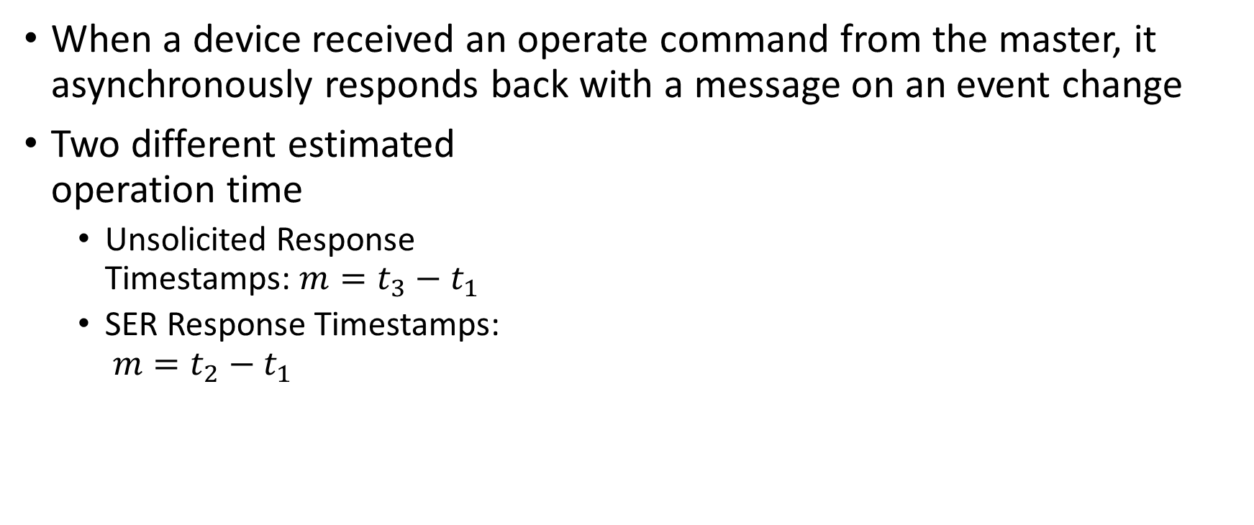
Method 2: Physical Fingerprinting
When a device received an operate command from the master, it asynchronously responds back with a message on an event change
Two different estimated operation time
Unsolicited Response Timestamps: $m=t_{3}−t_{1}$
SER Response Timestamps: $m=t_{2}−t_{1}$

Slide 22
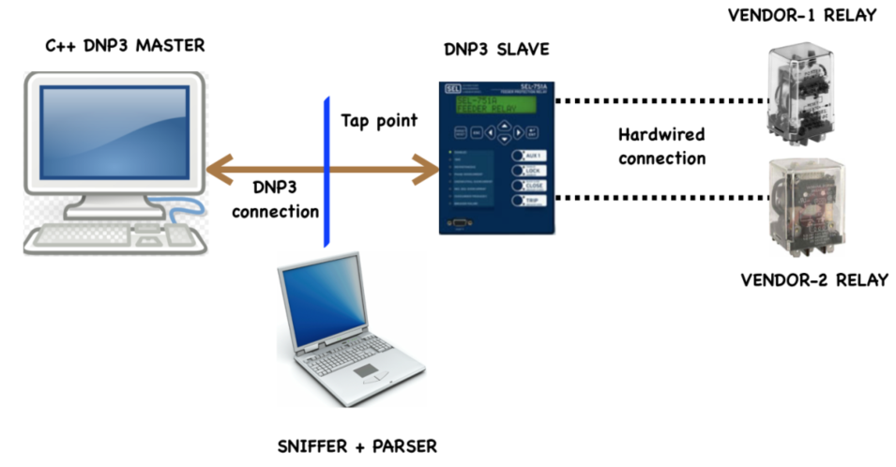
Method 2: Physical Fingerprinting
Experiment:
The unsolicited response method did not produce any usable results, so the SER method results are described below and retained as the physical fingerprint.

Slide 23
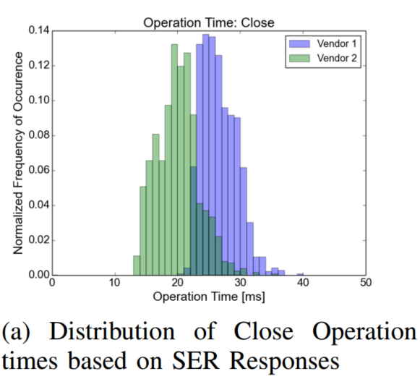
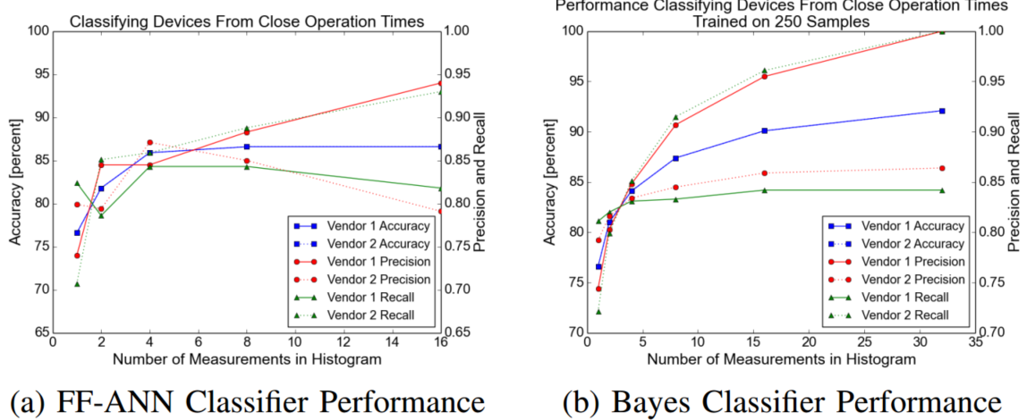
Method 2: Physical Fingerprinting
Result of Close Operation

Slide 24
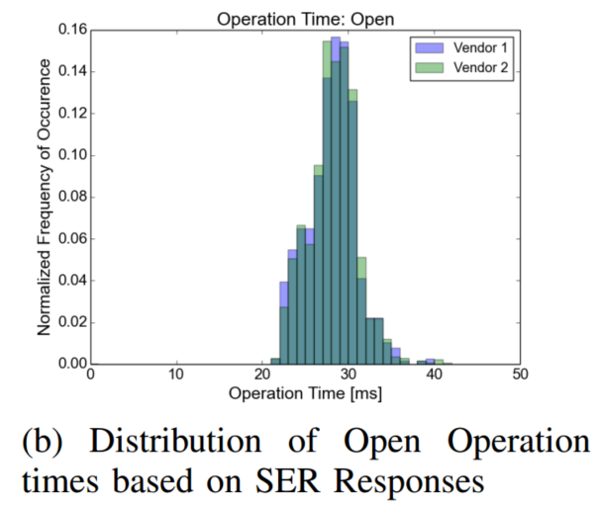
Method 2: Physical Fingerprinting
Result of Open Operation

Slide 25
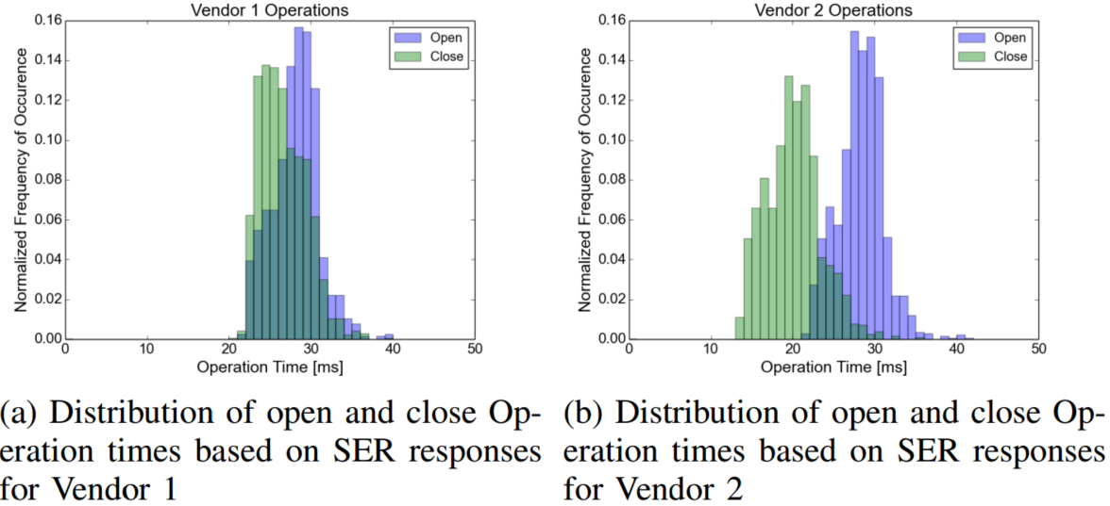
Method 2: Physical Fingerprinting
Difference between Operations

Slide 26
Synthetic Fingerprint Generation
The fingerprint (or signature) of a device can be represented as a probability density function (PDF) of the response times described above.
To generate these PDFs, there are three approaches can be used:
white box modeling
black box modeling
gray box modeling

Slide 27
Synthetic Fingerprint Generation
Due to the abundance of measurements in the available dataset and lack of proprietary source code, the cross-layer fingerprinting method focuses on a black box modeling approach.
In the case of the physical fingerprinting technique, they proposes a new class of fingerprint generation on white box modeling.

Slide 28
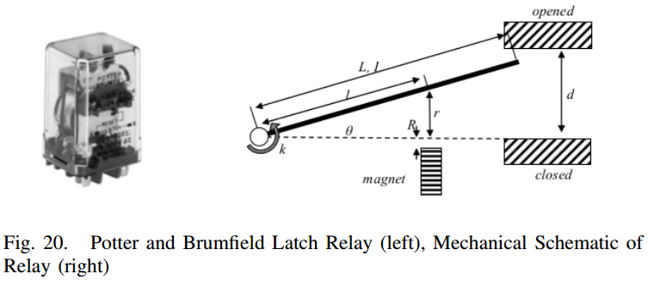
Synthetic Fingerprint Generation
They consider a standard latch relay like the Potter and Brumfield KUL Series relay, disassembled it and modeled its basic component.

Slide 29
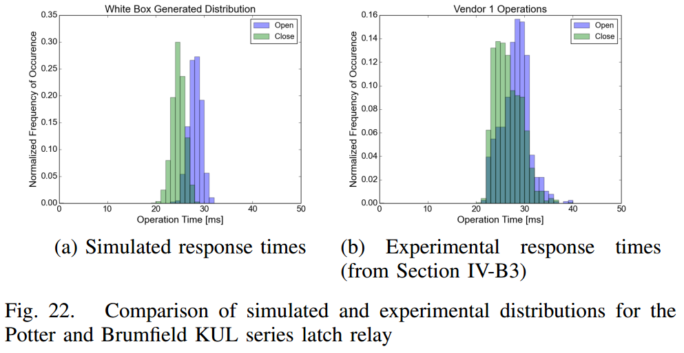
Synthetic Fingerprint Generation
The similarity in these distributions demonstrates that the mechanical response characteristics can be adequately captured with this parameterized dynamic model.

Slide 30
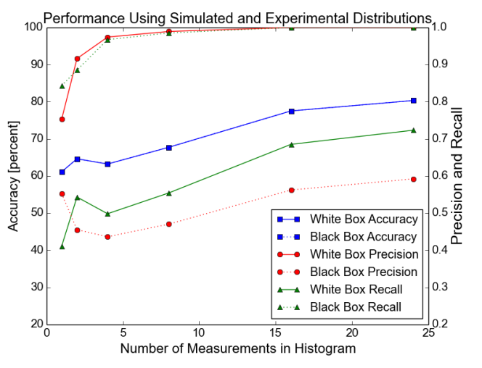
Synthetic Fingerprint Generation
They used FF-ANN trained from the simulated distribution for one device and experimental measurements from the other device.
With classification accuracy leveling off around 80% as shown.

Slide 31
Discussion - Performance
Accuracy
Neither method was able to obtain the near-perfect classification accuracy needed for an effective stand-alone intrusion detection system
But both achieved high enough accuracy to prove useful in a defense-in-breadth strategy as a supplement to traditional IDS approaches.
Scalability
The FF-ANN algorithm used in training only had one hidden layer and 200 input features, resulting in reasonable scalability for computational complexity.

Slide 32
Discussion - Robustness Against Forgery
There are several reasons as to why the proposed methods are not so easily broken.
First, there is always going to be inherent randomness in the attacker’s machine that makes it non-trivial to perfectly reproduce anything based on precision timing.
Second, for the physical fingerprinting method the adversary machine’s clock must stay synchronized with the target device’s clock to millisecond precision.

Slide 33
Discussion - Robustness Against Forgery
Remember ….
They consider two different attacker models:
1) an outsider who is unable to gain physical access but has compromised a low powered node in the network with malware
2) an outsider who is feasibly able to gain physical access to the target network and use her own portable machine with standard laptop computing power.
Limitation
it is not certain that the compromised device would even have a network card that supports promiscuous mode for network sniffing.
Additionally, any sniffing code installed on a low powered, compromised device would most likely be computationally expensive enough to skew timing measurements on the system.

Slide 34
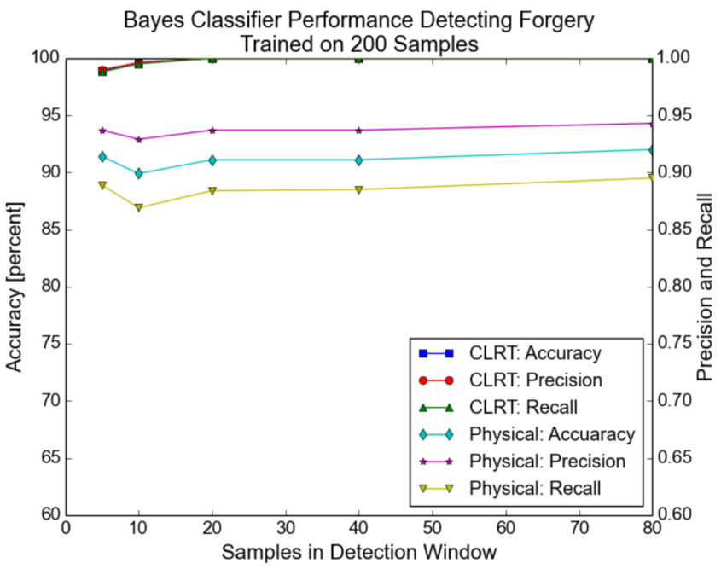
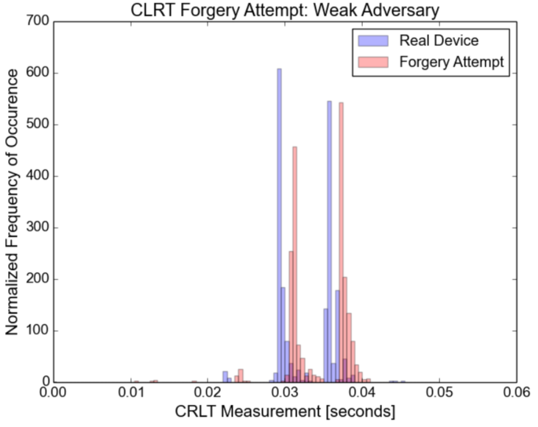
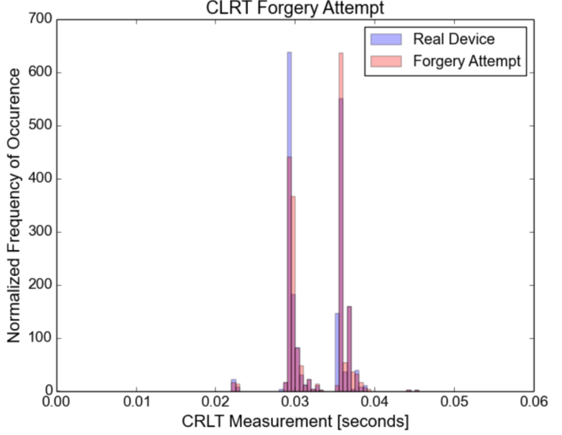
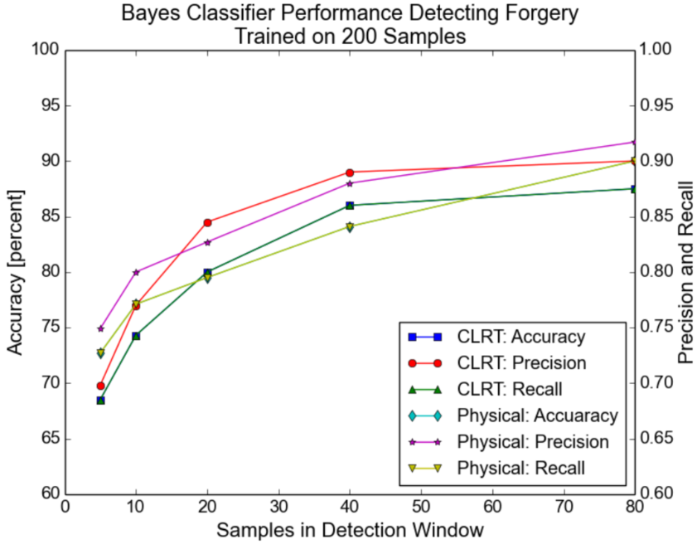
Discussion - Robustness Against Forgery
Cross-Layer Response Time Forgery

Slide 35
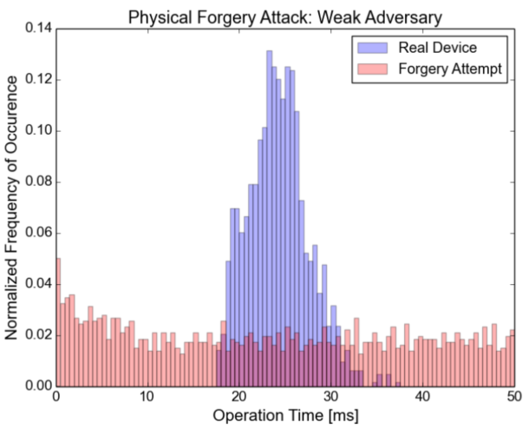
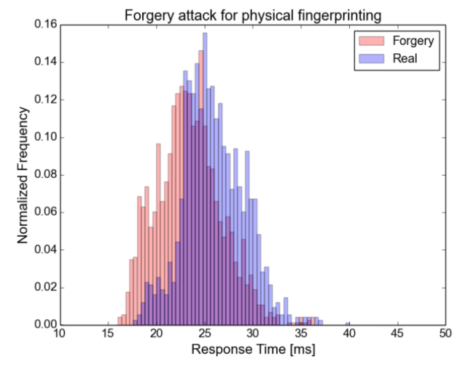
Discussion - Robustness Against Forgery
Physical Fingerprinting Operation Time Forgery

Slide 36
Discussion - Robustness Against Forgery
Even though both fingerprinting techniques exhibit resistance to these forgery attacks, they admit it is still possible that an attacker could more intelligently shape her response times to more closely match the true fingerprint
However, this would require a significantly more knowledgeable and skilled adversary to successfully accomplish

Slide 37
Discussion – Limitation
The cross-layer fingerprinting method requires a SCADA protocol using “Read” and “Response” messages. Furthermore, the SCADA protocol must sit on top of a TCP implementation that uses at least a minimum amount of “quick ACKs”.
The physical fingerprinting method must be used with protocols that include operation timestamps in their responses.
This work would result in an impractical number of false alarms if each mis-classification was treated directly as an intrusion.

Slide 38
Discussion – Limitation
Limitations of White Box Modeling
In some cases it is possible that mechanical design data will be difficult to obtain, for instance due to intellectual property concerns.
Unmodeled components and incorrect modeling assumptions

Slide 39
Conclusion and Future Work
They presented two novel methods for passively fingerprinting devices on ICS networks.
After evaluating the methods, fingerprint classification accuracies as high as 99% and 92% were achieved for the first and second methods respectively.
Both techniques exhibited resistance to simple forgery attacks and could feasibly be implemented alongside more traditional IDS solutions.
For future work, they plan to improve on the white box modeling and extend these methods to fingerprinting embedded devices in the “Internet of Things “.

